Slide 1

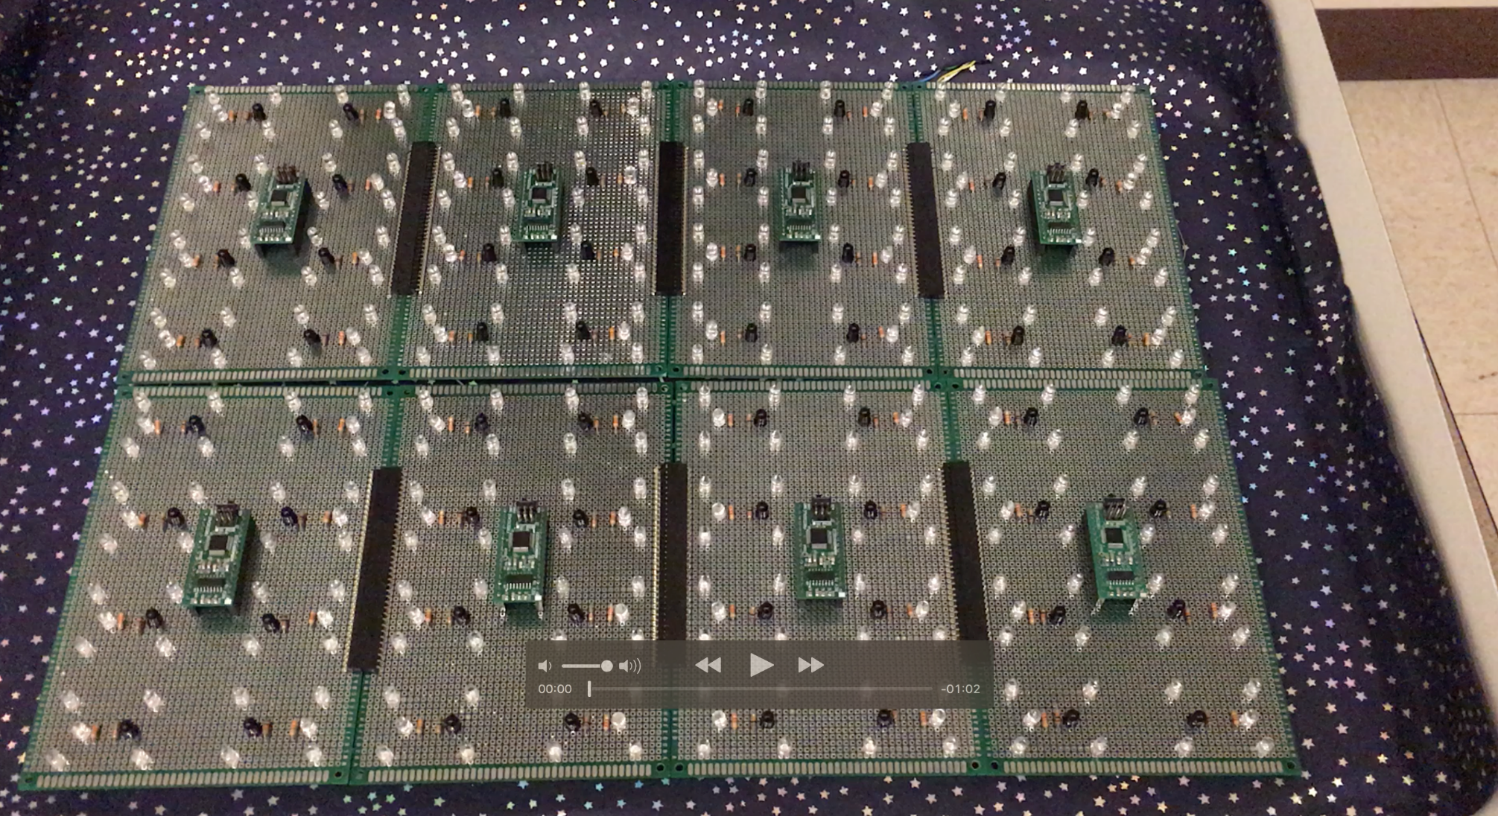
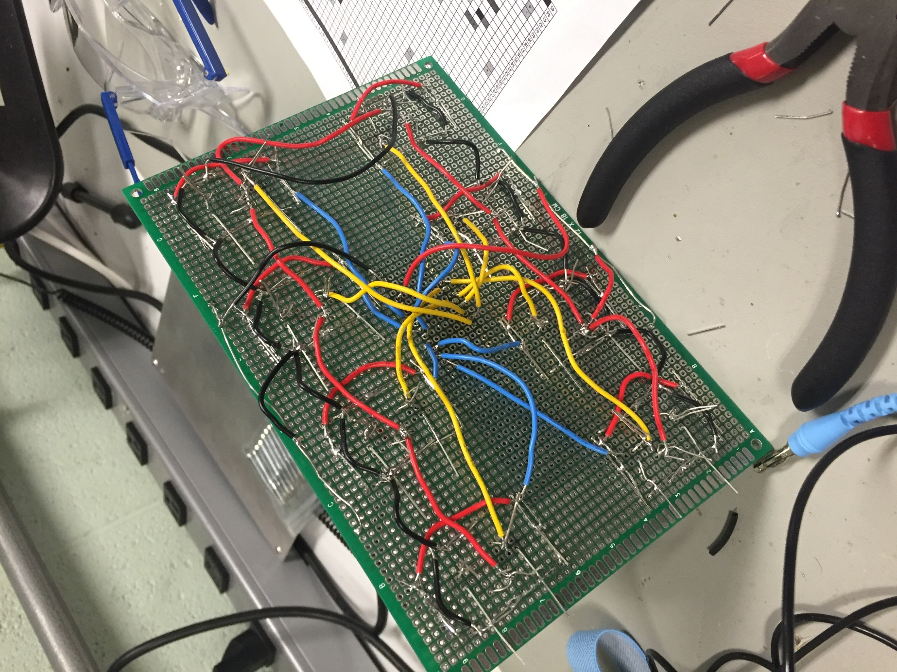



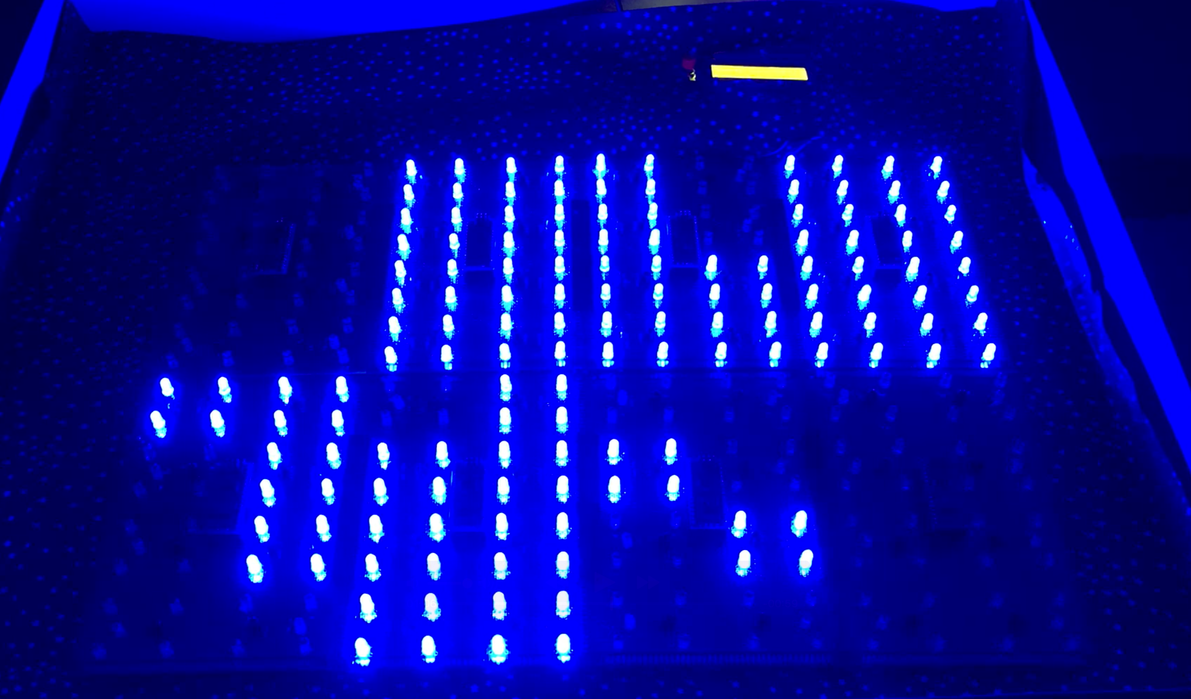

ECE 362 Embedded Microcontroller Mini-Project − Fall 2015
Team <No. 27> – <Magic Matrix>
TEAM MEMBERS:
JUNYAN SHI
MENGSHI FENG
ZHUOFAN LI
XIAOYUAN ZHANG
This project is an implementation of LED matrix that is reactive to object motion using MC9S12C32 (“9S12”) microcontroller. That is saying, when a nearby motion is being detected, the corresponding LED will turn on automatically, and turn off once the object is leaving the detectable area.
https://youtu.be/IR0iJOXhjO4
Digijock(ette)-Strength Digital System DesignTM

